Slide 1
RBAC Admin — Users & Roles
Flask + SQLite
Single-file app with API + frontend (roles & users)

Slide 2
Purpose & Key Features
Manage roles + privileges
Manage users + metadata
SQLite + SQLAlchemy
Single-file HTML/JS frontend
REST API
Auto-seeding

Slide 3
System Components Overview
Flask backend handling REST APIs
SQLite database for persistence
SQLAlchemy ORM for DB operations
Single-file frontend (Bootstrap + JS)
JSON-based privileges structure

Slide 4
Role Model — Purpose
Defines access control for each module
Stores per-module permissions (CRUD)
Controls what actions users can perform
Privileges stored as flexible JSON
Used by API & UI to enforce permissions
Connects users → roles → allowed operations

Slide 5
User Model — Purpose
Stores basic user identity & contact details
Maintains assigned role
Acts as the system's main user record
Supports CRUD operations
Drives the Users UI
"name" is treated as the unique identifier

Slide 6
DB Setup & Seeding
Auto-create tables
Update old DB columns if missing
Seed default roles & default users
Predefined module list for privileges

Slide 7
Roles API — What It Does
GET /api/roles — List roles
GET /api/roles/<id> — View specific role
POST /api/roles — Create role
PUT /api/roles/<id> — Update role
DELETE /api/roles/<id> — Delete role
POST /api/roles/<id>/duplicate — Duplicate role

Slide 8
Frontend (Single-File Architecture)
Served at /roles
Bootstrap UI
Sidebar for Users/Roles
Modal forms for CRUD
JS fetch() for API calls
Instant UI updates

Slide 9
How to Run
pip install flask flask_sqlalchemy
python main.py
URL: http://127.0.0.1:5000/roles
Database auto-creates on first run

Slide 10
Improvements & Next Steps
Add authentication for admin access
Move frontend to static HTML/JS files
Normalize privileges table
Add logs for auditing
Add unit tests

Slide 11

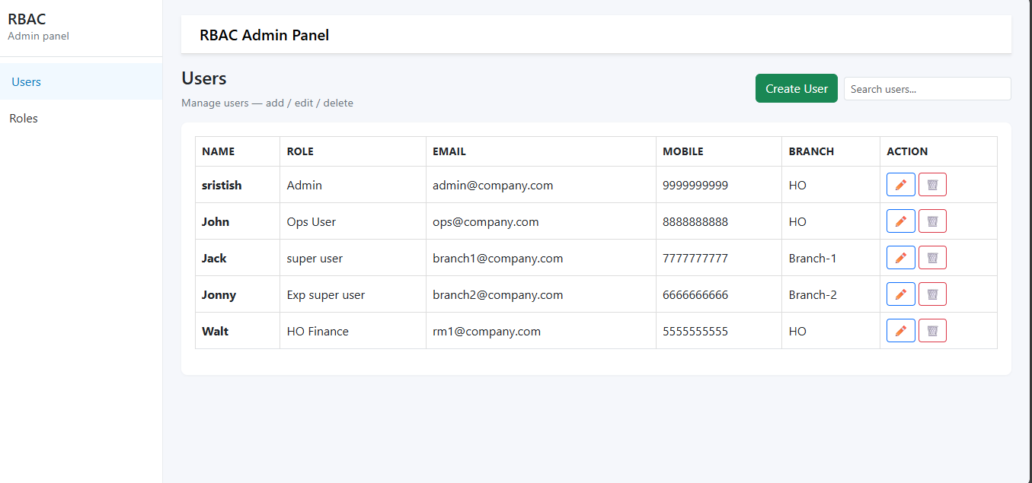
Users UI Screenshot

Slide 12
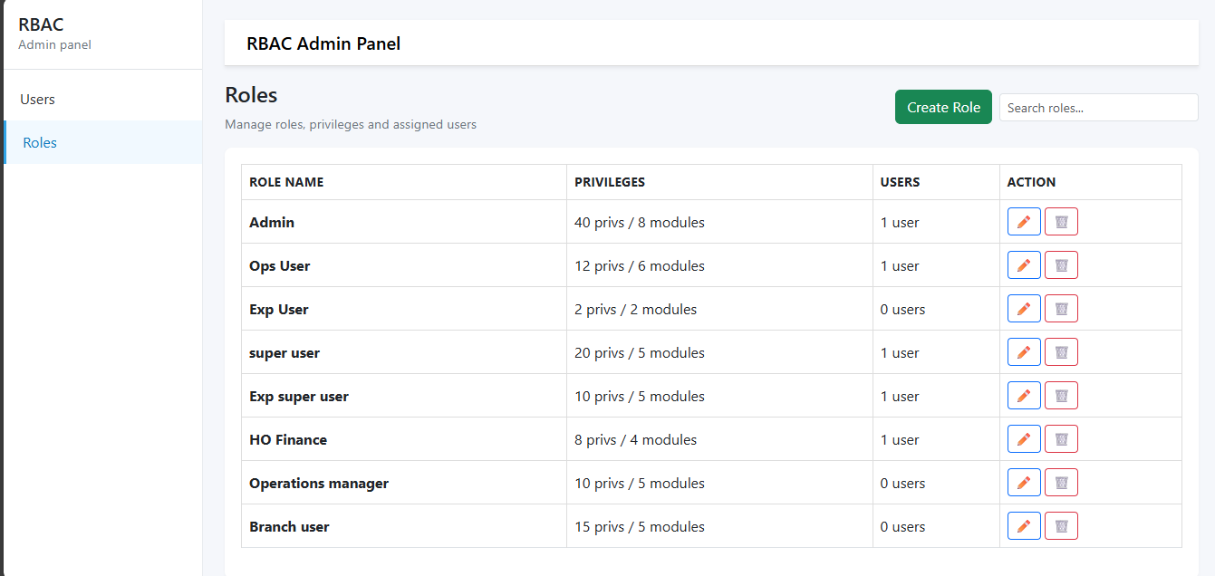
Roles UI Screenshot

Slide 13
Conclusion
Complete RBAC workflow
Clean modern UI
JSON-based privileges = flexible
Flask + SQLite = lightweight & portable
Suitable for demos & admin tools

Slide 14
Thank You
Questions are welcome.

